Slide 1
Remote Control Timer Switch
Hong-Shuo Chen

Slide 2
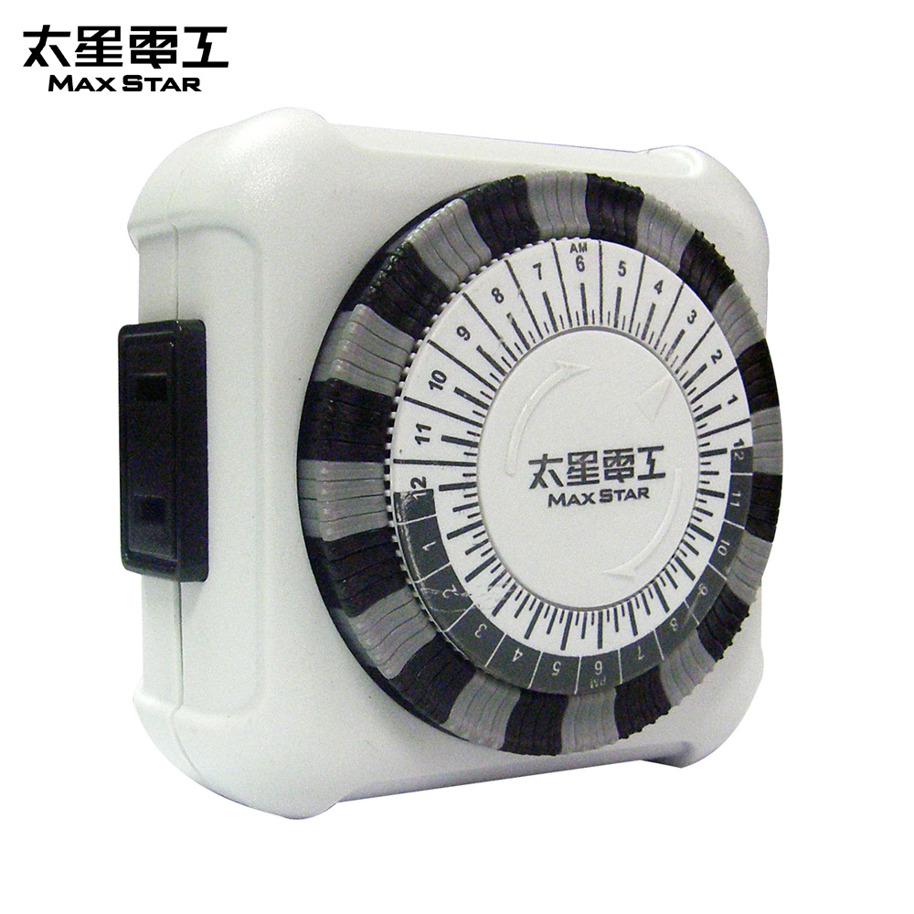
Motivation

Slide 3
Disadvantages
Rotate and press down segments on the timer
The time unit is fifteen minutes
The precision is not enough
……

Slide 4
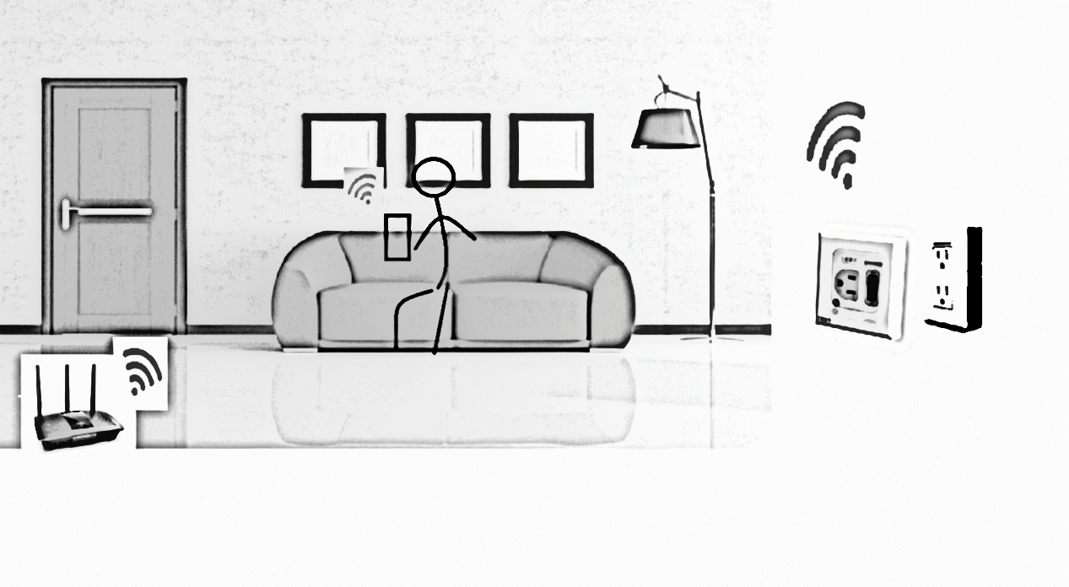
Product Architecture

Slide 5
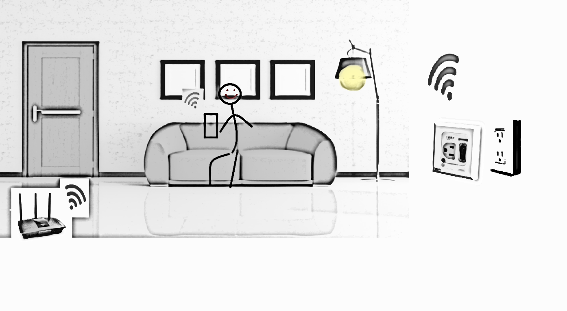
Product Architecture

Slide 6
Material and Equipment
4-Relay-DC5V-Module
ESP-12-ESP8266
Plug and Extension cord
Smartphone
Router

Slide 7
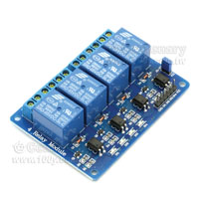
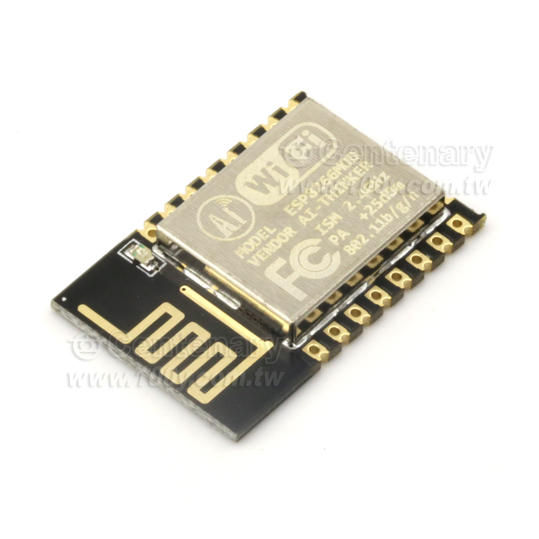

Slide 8


Slide 9
Thank you
Recommendation

